Slide 1
Foundations for Systematic Construction of Fault-Tolerant Quantum Gates
Uladzimir Kasacheuski & Guy Wiss

Slide 2
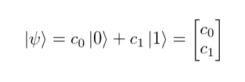
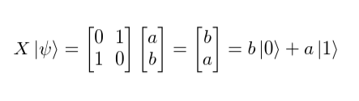
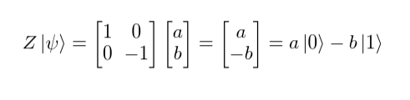
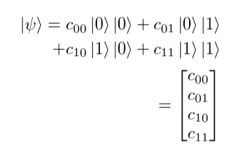
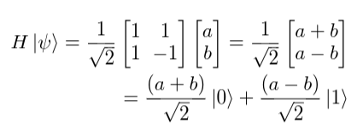

Commonly used gates + notation we’ll use

Slide 3
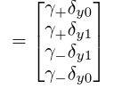


Entanglement and The Bell State
Entanglement - Where you can't have one without the other
...
… several steps later ...
What’s the difference?

Slide 4
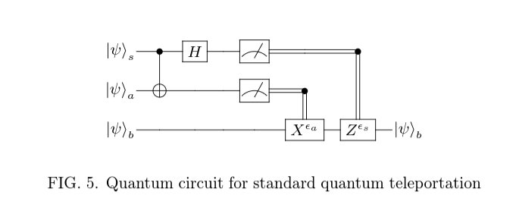
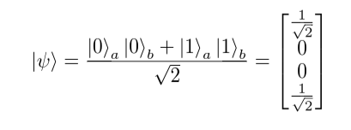

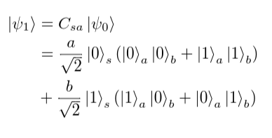
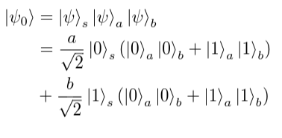
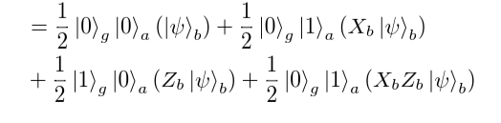
Teleportation - An Alice and Bob Adventure
… (several steps later) …

Slide 5
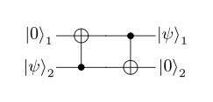
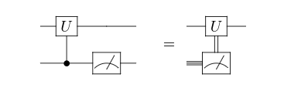
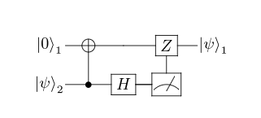
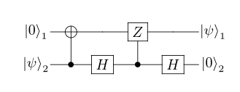
Lazy Standford’ers
Fact One
Fact Three
Thus
Fact Two
The Single Qubit “Z-Teleporter”!!!

Slide 6
So What?
Universality requires Two-Qubit and Single Qubit Gate (e.g., Z/X + CNOT)
Fault Tolerance can only be achieved in certain logical gate configurations
Enables systematic way to express any logical operation with fault tolerance through quantum teleporters
(We did the heavy lifting; showing how you can express ANY logical operation and why its fault tolerant is easy…)

Slide 7
Tricks for Evaluating
Keep track of what qubit each operation is acting on.
Similar to applying (S_z)|1 0>, decompose state and operator and act appropriately.
Working out all the simple operations first very useful.

